Slide 1
Causal Inference for Complex Observational Data Using Stata
Chuck Huber
StataCorp
chuber@stata.com
Stata Webinar
December 5, 2018

Slide 2
ERMs Outline
Description of the dataset
Unobserved confounding and endogeneity
Nonrandom treatment assignment
Missing not at random (MNAR) and selection bias
Treatment effects

Slide 3


The Research Question
Fictional State University (FSU) has developed a new study-skills program with the goal of improving the grade point averages of their students.

Slide 4
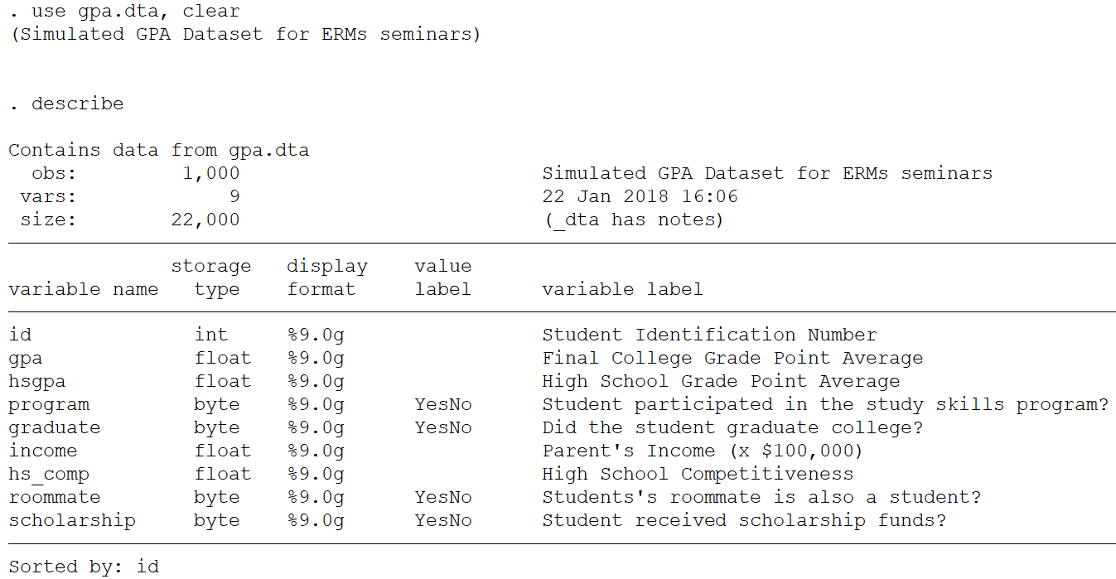
The Data

Slide 5
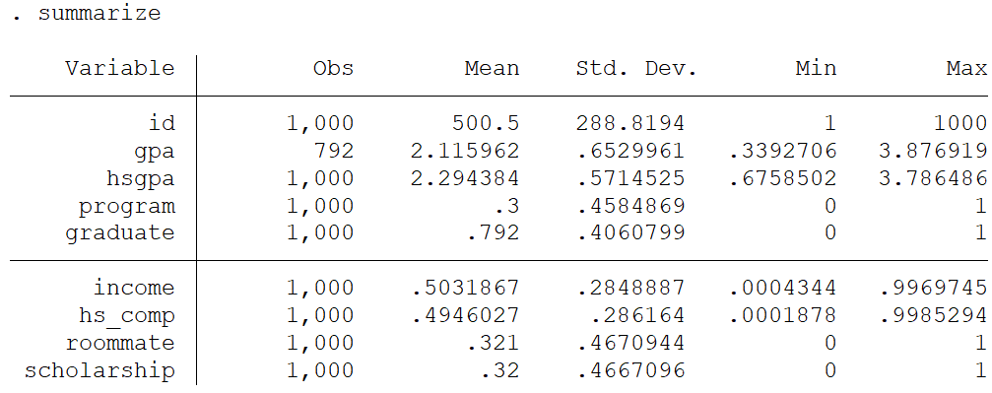
The Data

Slide 6
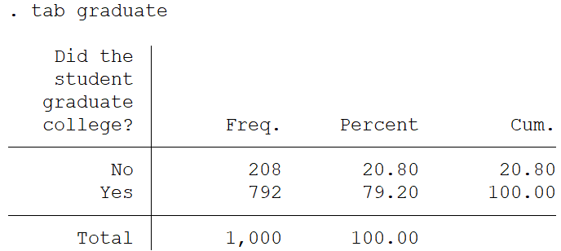
The Data

Slide 7
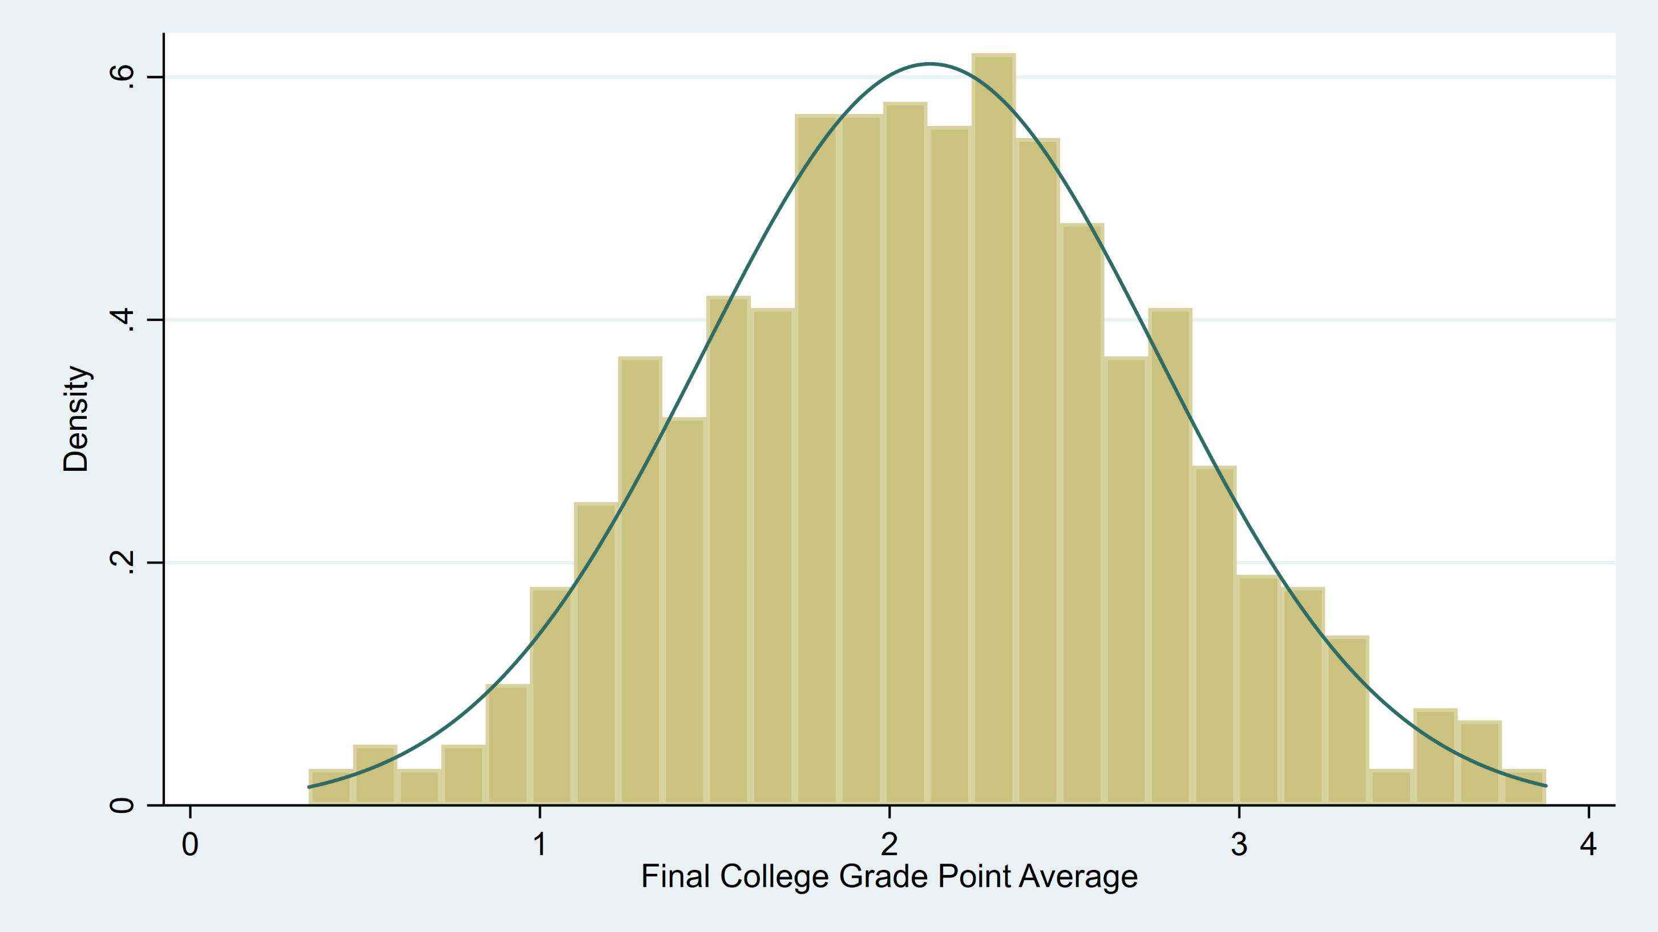
The Data

Slide 8
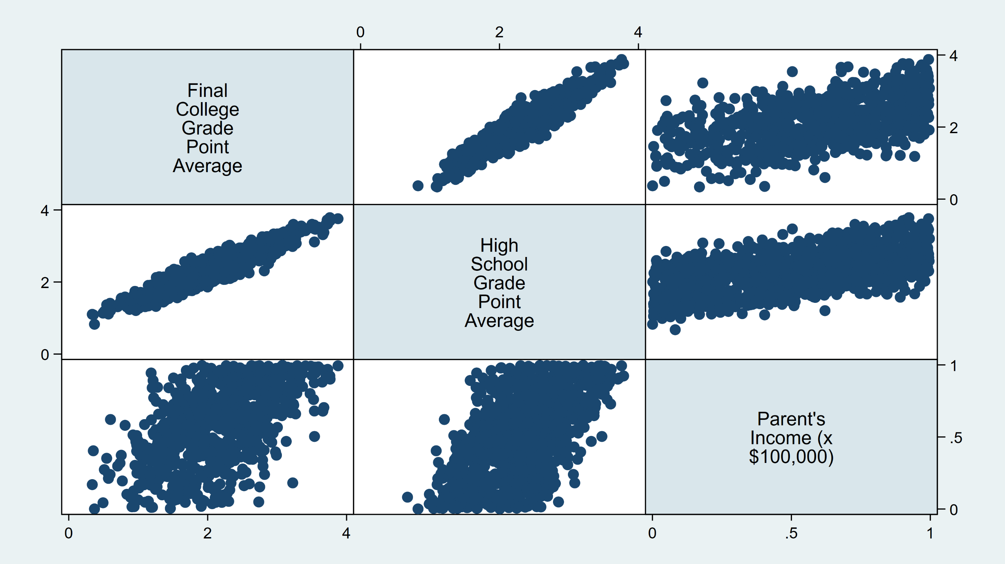
The Data

Slide 9
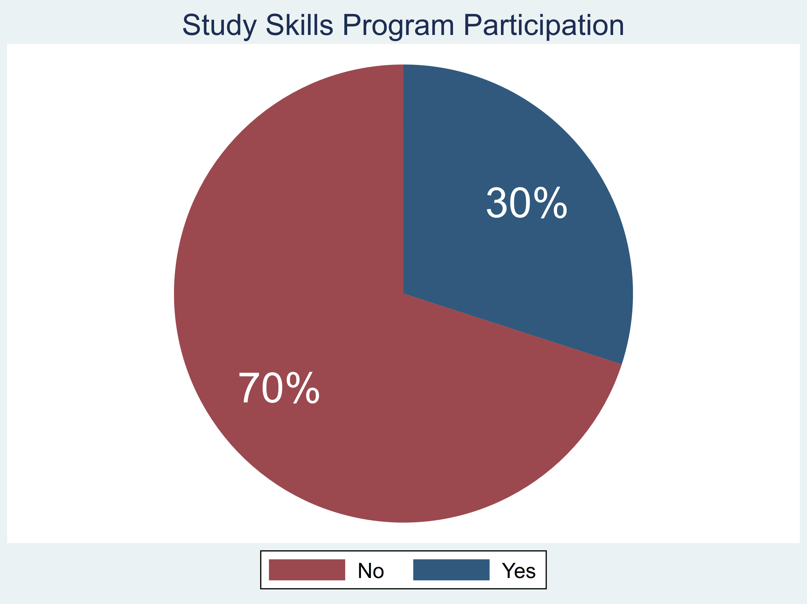
The Data

Slide 10
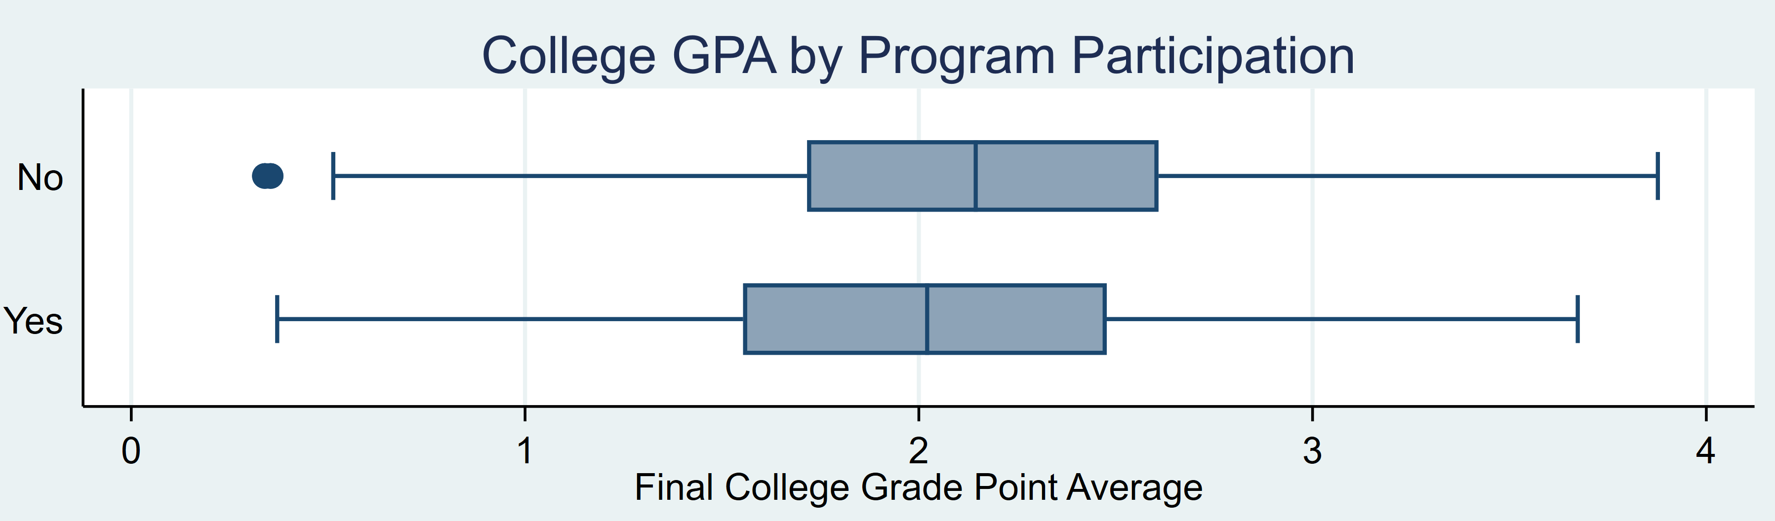
The Data

Slide 11
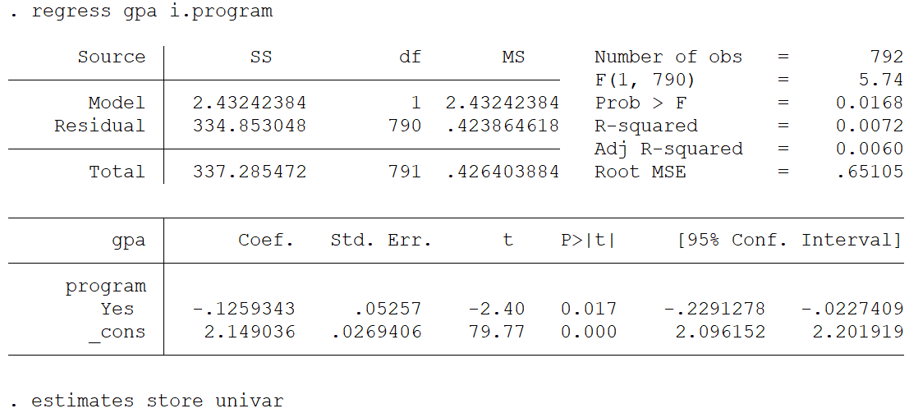
The Data
Students who participated in the program had lower GPAs?!?!?

Slide 12
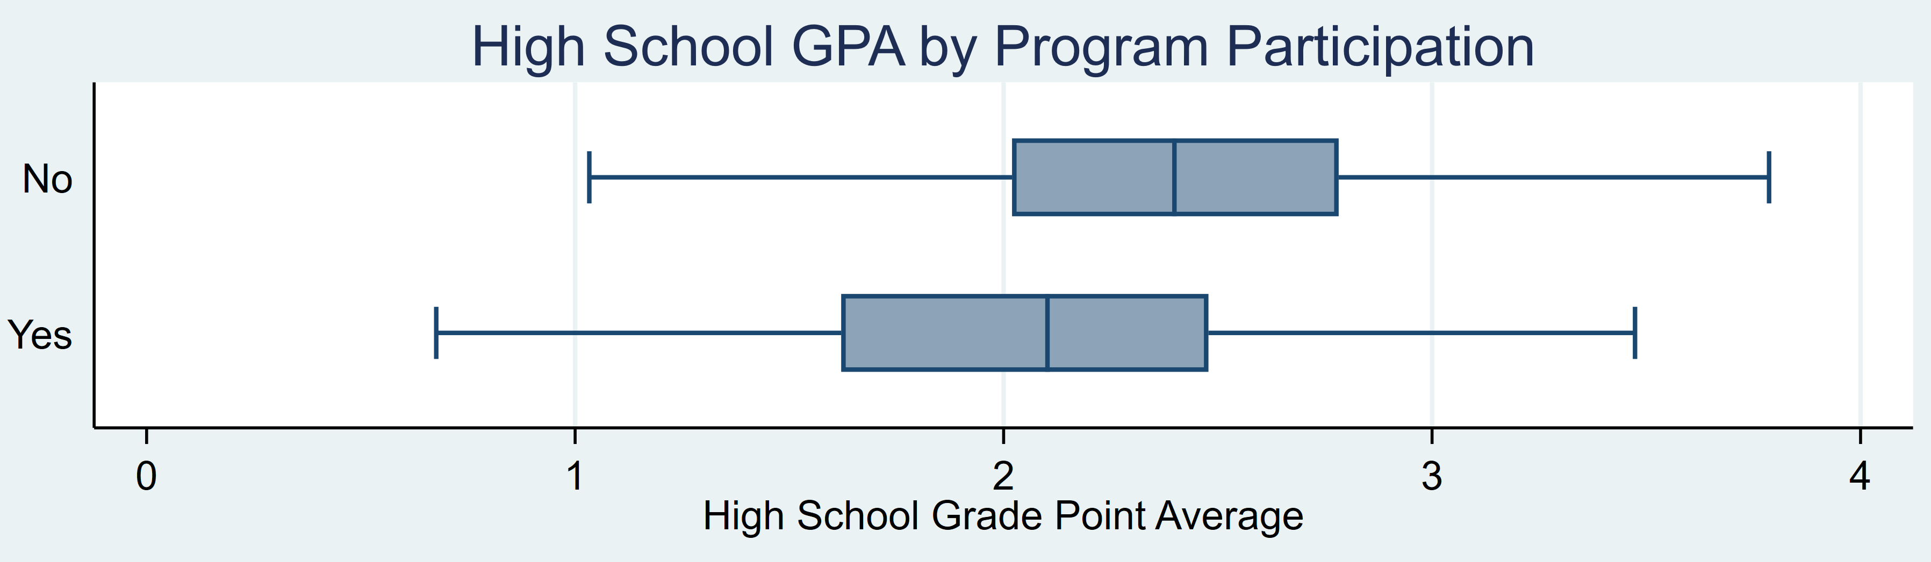
The Data

Slide 13
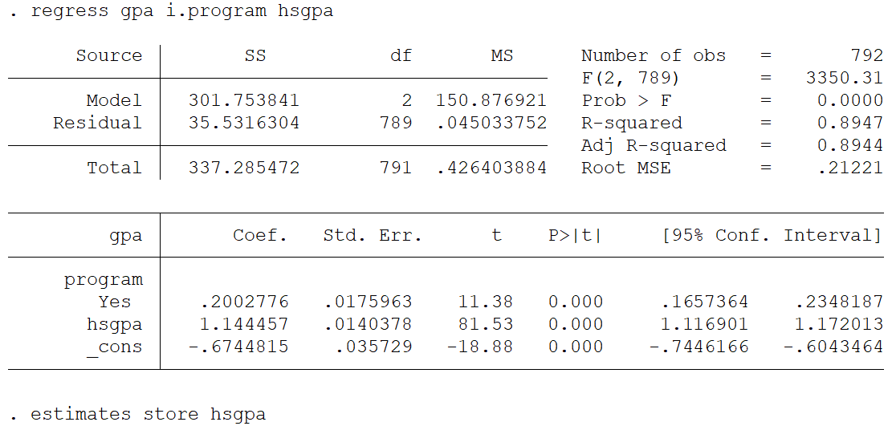
The Data
Students who participated in the program had
higher GPAs when we account for high school GPA.

Slide 14
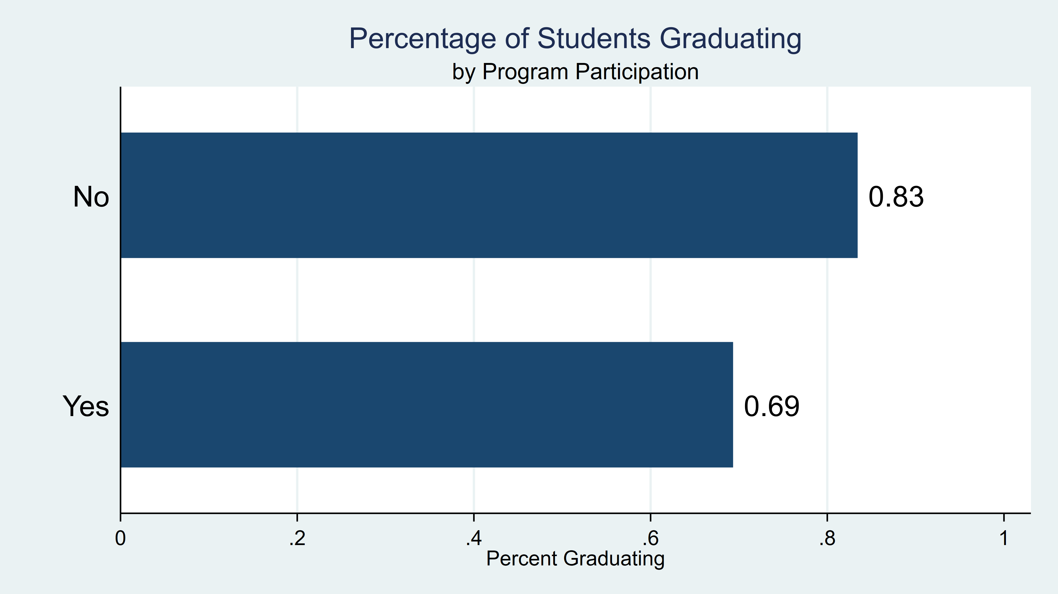
The Data

Slide 15
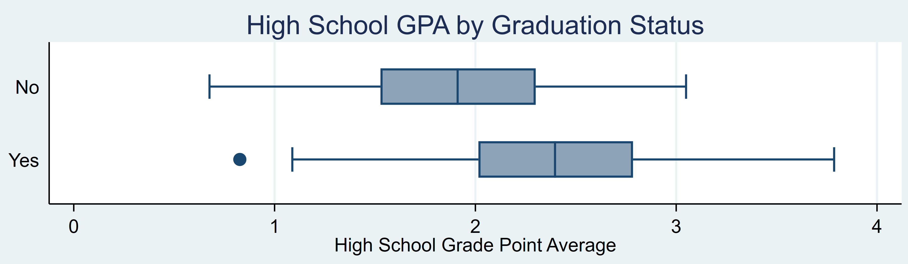
The Data

Slide 16
The Data
What was the effect of the study
program on students GPAs?

Slide 17

Outline
Description of the dataset
Unobserved confounding and endogeneity
Nonrandom treatment assignment
Missing not at random (MNAR) and selection bias
Treatment effects

Slide 18
Observed and Unobserved Factors
$$y=all factors that influence y$$
$$y=observed factors+unobserved factors$$
$$y= β_{0}+β_{1}x_{1}+ ⋯+β_{k}x_{k}+ε$$

Slide 19
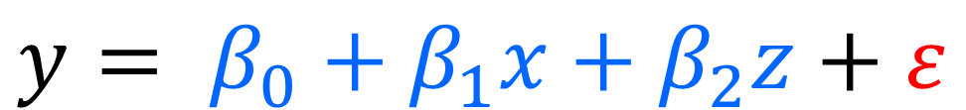
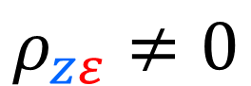
Endogeneity
“An explanatory variable in a multiple regression model that is correlated with the error term…” (Wooldridge*, pg 838).
$$y= β_{0}+β_{1}x+β_{2}z+ε$$
$$ρ_{zε}≠0$$
*Jeffrey M. Wooldridge (2009) Introductory Econometrics: A Modern Approach, 4th ed.

Slide 20
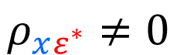
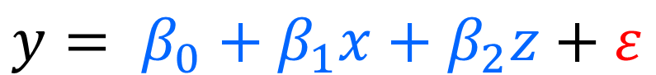
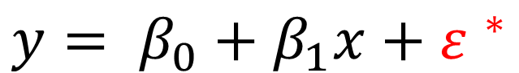
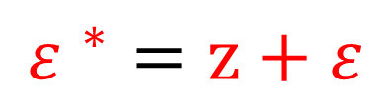
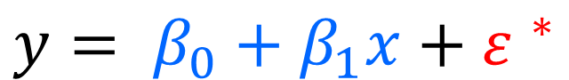
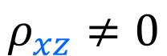
Omitted Variable Bias
$$y= β_{0}+β_{1}x+β_{2}z+ε$$
$$ρ_{xz}≠0$$
$$y= β_{0}+β_{1}x+{ε }^{∗}$$
$${ε }^{∗}=z+ε$$
$$y= β_{0}+β_{1}x+{ε }^{∗}$$
$$ρ_{xε^{∗}}≠0$$

Slide 21
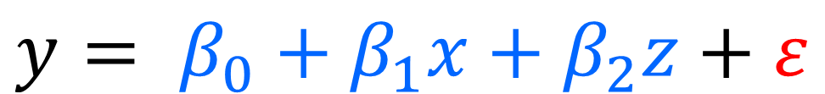
Confounding
“…X and Y are confounded when there is a third variable Z that influences both X and Y…” (Pearl*, pg 193).
$$y= β_{0}+β_{1}x+β_{2}z+ε$$
*Judea Pearl (2009) Causality: Models, Reasoning, and Inference, 2nd ed.

Slide 22
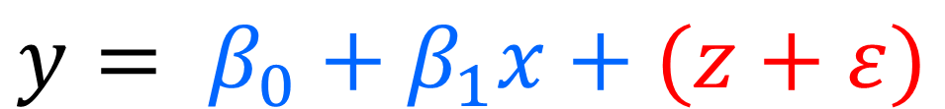
Unobserved Confounding
$$y= β_{0}+β_{1}x+(z+ε)$$

Slide 23
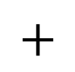
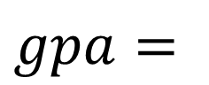
Observed and Unobserved Factors
$$gpa=all factors that influence gpa$$
$$gpa=observed factors+unobserved factors$$
High school GPA
SAT Scores
Parents Income
Sex
etc…
Ability
Motivation
Sleep
Support
etc…
$$gpa=$$
$$+$$
$$gpa= β_{0}+β_{1}x_{1}+ ⋯+β_{k}x_{k}+ε$$

Slide 24
Unobserved Confounding
$$gpa= β_{0}+β_{1}income+β_{2}hsgpa+ε_{total}$$
$gpa=β_{0}+β_{1}income+β_{2}hsgpa+(Ability+ε$)

Slide 25
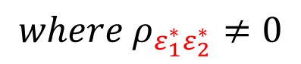
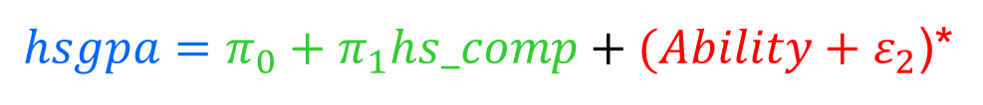
Unobserved Confounding and Endogeneity
$gpa=β_{0}+β_{1}income+β_{2}(hsgpa)+(Ability+ε_{1}$)
${hsgpa=π_{0}+π}_{1}hs_comp+(Ability+ε_{2}$)*
$gpa=β_{0}+β_{1}income+β_{2}({π_{0}+π}_{1}hs_comp)+(Ability+ε_{1}$)*
$${where ρ}_{ε_{1}^{∗}ε_{2}^{∗}}≠0$$
hsgpa = (factors NOT related to Ability) + (Ability + error)

Slide 26
Unobserved Confounding and Endogeneity
$gpa=β_{0}+β_{1}income+β_{2}hsgpa+(Ability+ε$)
hsgpa
Ability
income
gpa
ε

Slide 27
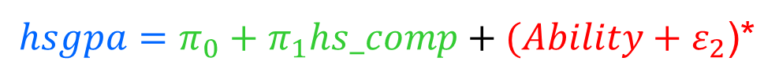
Unobserved Confounding and Endogeneity
${hsgpa=π_{0}+π}_{1}hs_comp+(Ability+ε_{2}$)*
$gpa=β_{0}+β_{1}income+β_{2}({π_{0}+π}_{1}hs_comp)+(Ability+ε_{1}$)*
hs_comp
hsgpa
ε₂
Ability
income
gpa
ε₁

Slide 28
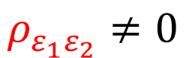
Unobserved Confounding and Endogeneity
hs_comp
hsgpa
ε₂
$$ρ_{ε_{1}ε_{2}}≠0$$
income
gpa
ε₁

Slide 29

Unobserved Confounding and Endogeneity
${hsgpa=π_{0}+π}_{1}hs_comp+(Ability+ε_{2}$)*
$gpa=β_{0}+β_{1}income+β_{2}({π_{0}+π}_{1}hs_comp)+(Ability+ε_{1}$)*
hs_comp
hsgpa
ε₂
Ability
income
gpa
Ability
ε₁

Slide 30
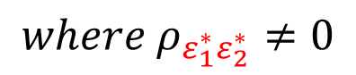
Unobserved Confounding and Endogeneity
${hsgpa=π_{0}+π}_{1}hs_comp+(Ability+ε_{2}$)*
$gpa=β_{0}+β_{1}income+β_{2}({π_{0}+π}_{1}hs_comp)+(Ability+ε_{1}$)*
$${where ρ}_{ε_{1}^{∗}ε_{2}^{∗}}≠0$$
hs_comp
hsgpa
ε₂
Ability
income
gpa
ε₁

Slide 31
Unobserved Confounding and Endogeneity
hs_comp
hsgpa
ε₂
$$ρ_{ε_{1}ε_{2}}≠0$$
income
gpa
ε₁

Slide 32
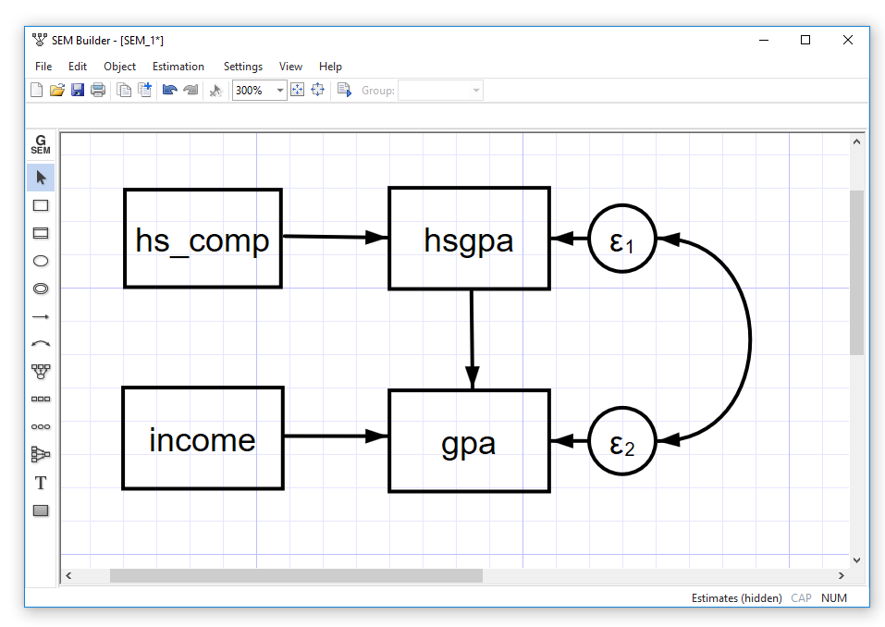
Unobserved Confounding and Endogeneity

Slide 33
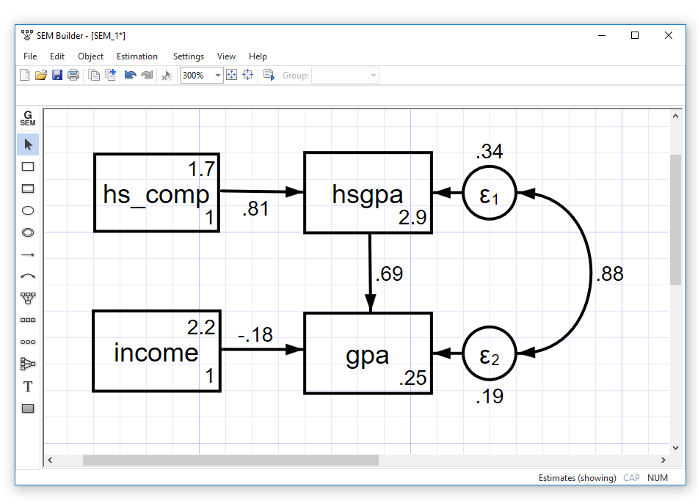
Unobserved Confounding and Endogeneity

Slide 34
Unobserved Confounding and Endogeneity
Primary model
eregress gpa income, ///
endogenous(hsgpa = hs_comp income)
Auxillary model

Slide 35
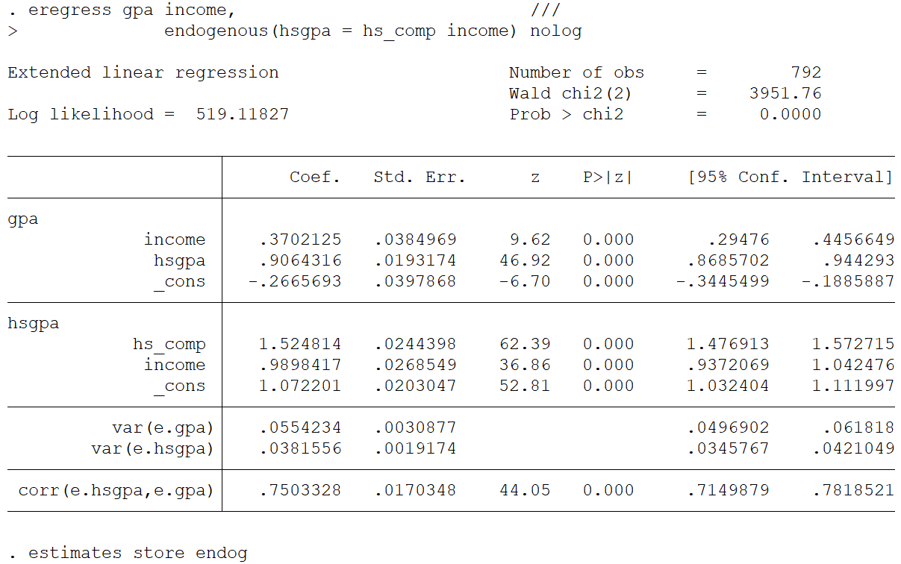
Unobserved Confounding and Endogeneity

Slide 36
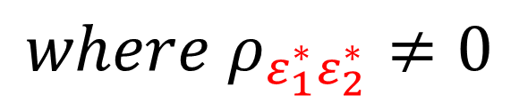
Unobserved Confounding and Endogeneity
$${where ρ}_{ε_{1}^{∗}ε_{2}^{∗}}≠0$$

Slide 37
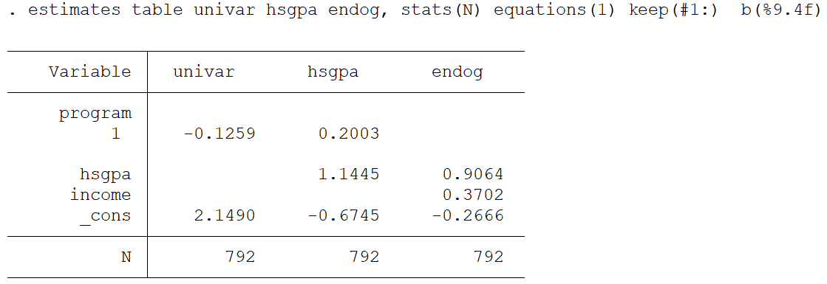
Unobserved Confounding and Endogeneity

Slide 38
Outline
Description of the dataset
Unobserved confounding and endogeneity
Nonrandom treatment assignment
Missing not at random (MNAR) and selection bias
Treatment effects

Slide 39
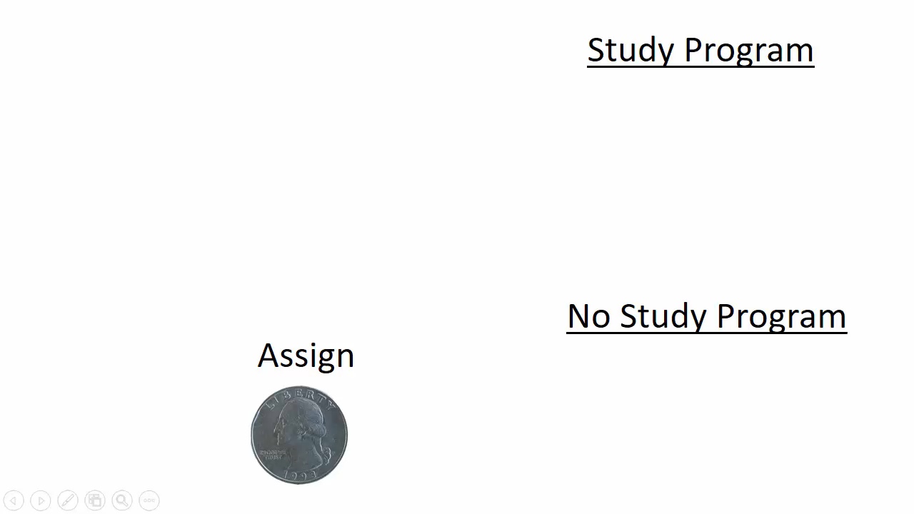
Random Treatment Assignment

Slide 40
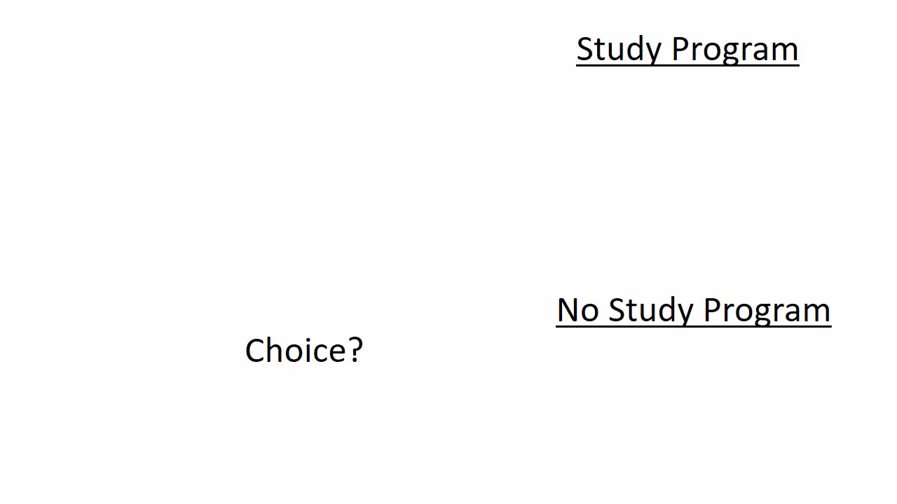
Nonrandom Treatment Assignment

Slide 41
Nonrandom Treatment Assignment
A student’s decision to enroll in the study program
is based on observed and unobserved factors.
$$P(program=1)=observed factors+unobserved factors$$

Slide 42
Unobserved Confounding
$$gpa= β_{0}+β_{1}income+β_{2}program+ε_{total}$$
$gpa=β_{0}+β_{1}income+β_{2}program+(Ability+ε$)

Slide 43

Endogenous Treatment
$gpa=β_{0}+β_{1}income+β_{2}(program)+(Ability+ε_{1}$)
${P(program=1)=π_{0}+π}_{1}scholarship+(Ability+ε_{3}$)*
$gpa=β_{0}+β_{1}income+β_{2}({π_{0}+π}_{1}scholarship)+(Ability+ε_{1}$)*
$${where ρ}_{ε_{1}^{∗}ε_{3}^{∗}}≠0$$
P(program=1) = (factors NOT related to Ability) + (Ability + error)

Slide 44
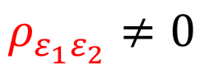
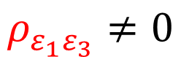
Endogenous Treatment
hs_comp
hsgpa
ε₂
$$ρ_{ε_{1}ε_{2}}≠0$$
income
gpa
ε₁
$$ρ_{ε_{1}ε_{3}}≠0$$
scholarship
P(program=1)
ε₃

Slide 45
Endogenous Treatment
Primary model
eregress gpa income, ///
endogenous(hsgpa = hs_comp income) ///
entreat(program = income scholarship, nointeract)
Auxillary model

Slide 46
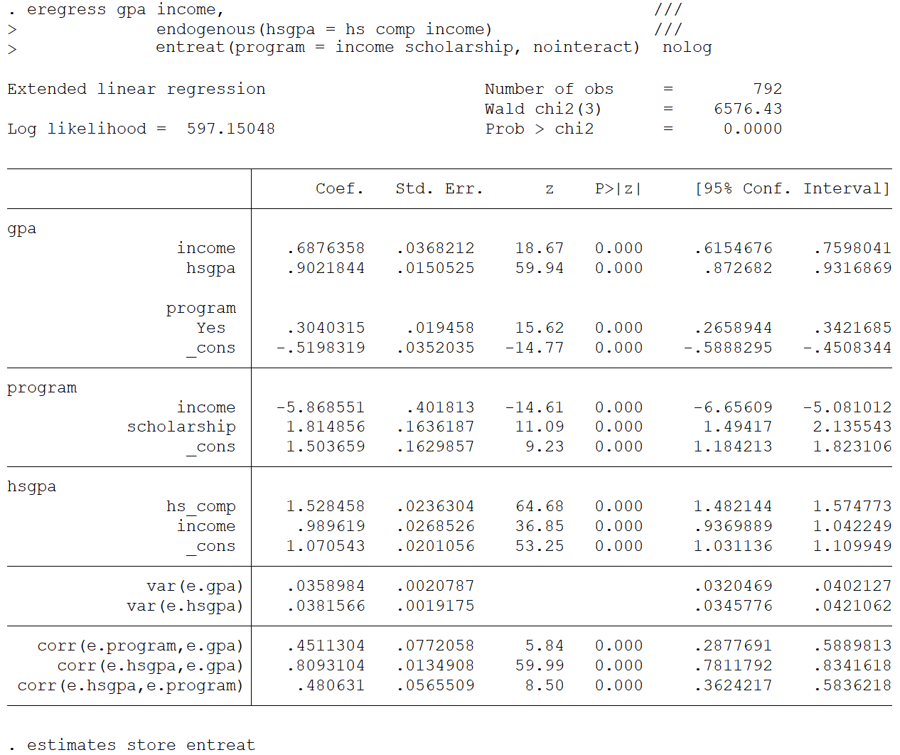
Endogenous Treatment

Slide 47

Endogenous Treatment
$${where ρ}_{ε_{1}^{∗}ε_{3}^{∗}}≠0$$

Slide 48
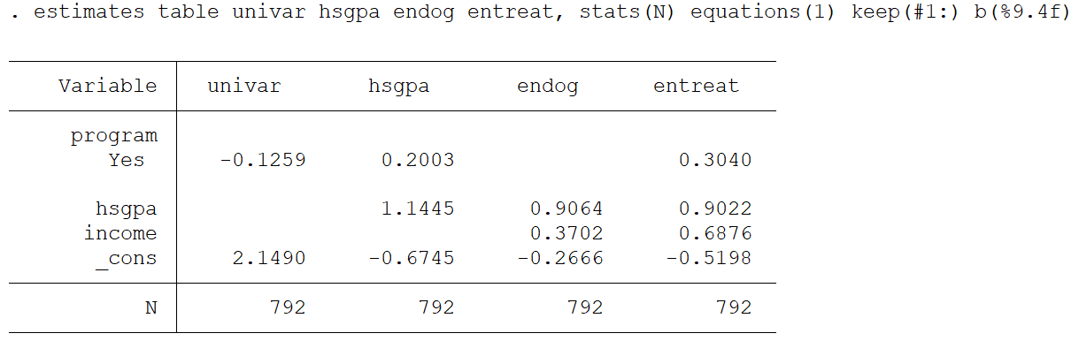
Endogenous Treatment

Slide 49
Outline
Description of the dataset
Unobserved confounding and endogeneity
Nonrandom treatment assignment
Missing not at random (MNAR) and selection bias
Treatment effects

Slide 50
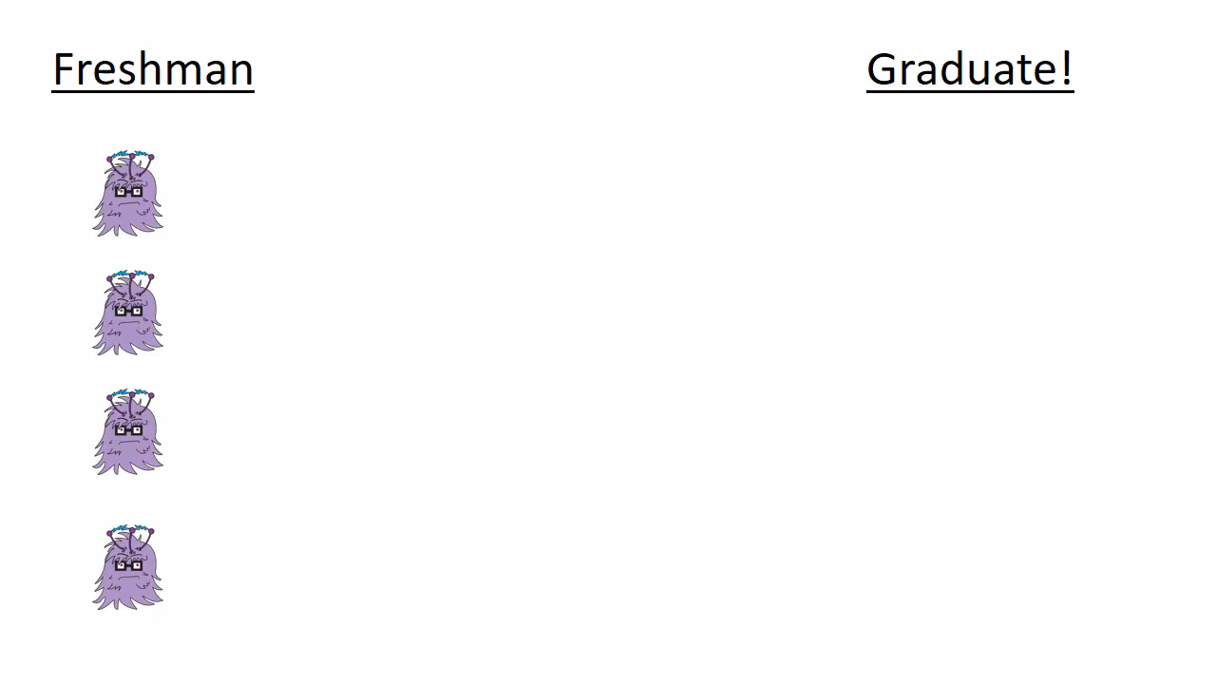
No Missingness

Slide 51
Missing Completely at Random (MCAR)

Slide 52
Missing at Random (MAR)

Slide 53
Missing Not at Random (MNAR)

Slide 54
MNAR and Selection Bias

Slide 55
Endogenous Sample Selection
A student’s decision to drop out of school is
based on observed and unobserved factors.
$$P(graduate=1)=observed factors+unobserved factors$$

Slide 56
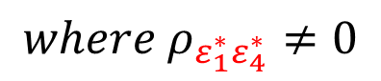
Endogenous Sample Selection
$$gpa=\left\{\begin{matrix}β_{0}+β_{1}income+β_{2}(program)+(Ability+ε_{1}\text{)}\text{∗} \text{if} \text{graduate}\text{=1} \\ missing \text{if} \text{graduate}\text{=}\text{0}\end{matrix}\right.$$
${P(graduate=1)=π_{0}+π}_{1}roommate+(Ability+ε_{4}$)*
$${where ρ}_{ε_{1}^{∗}ε_{4}^{∗}}≠0$$

Slide 57
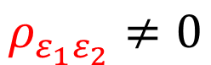
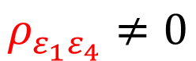
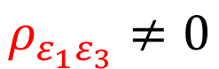
Endogenous Sample Selection
hs_comp
hsgpa
ε₂
$$ρ_{ε_{1}ε_{2}}≠0$$
income
gpa
ε₁
$$ρ_{ε_{1}ε_{3}}≠0$$
scholarship
P(program=1)
$$ρ_{ε_{1}ε_{4}}≠0$$
ε₃
roommate
P(graduate=1)
ε₄

Slide 58
Endogenous Sample Selection
Primary model
eregress gpa income, ///
endogenous(hsgpa = hs_comp income) ///
entreat(program = income scholarship, nointeract) ///
select(graduate = income roommate)
Auxillary model

Slide 59
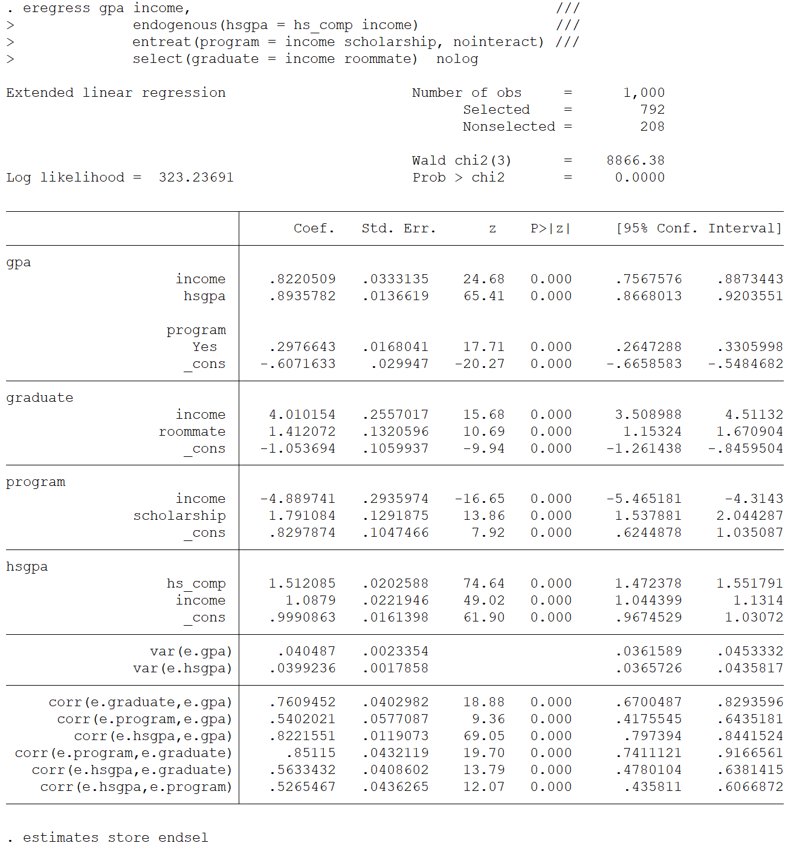
Endogenous Sample Selection

Slide 60
Endogenous Sample Selection

Slide 61
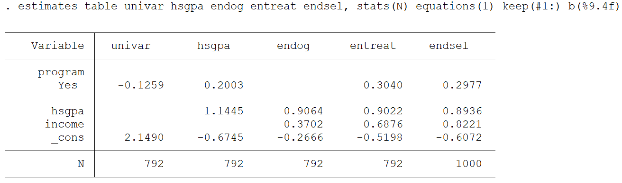
Endogenous Sample Selection
True Model (simulated)
gpa = -0.6 + 0.3*treatment + 0.9*hsgpa + 0.8*income

Slide 62
Outline
Description of the dataset
Unobserved confounding and endogeneity
Nonrandom treatment assignment
Missing not at random (MNAR) and selection bias
Treatment effects

Slide 63
ERM Postestimation
estat teffects
margins
marginsplot
predict

Slide 64
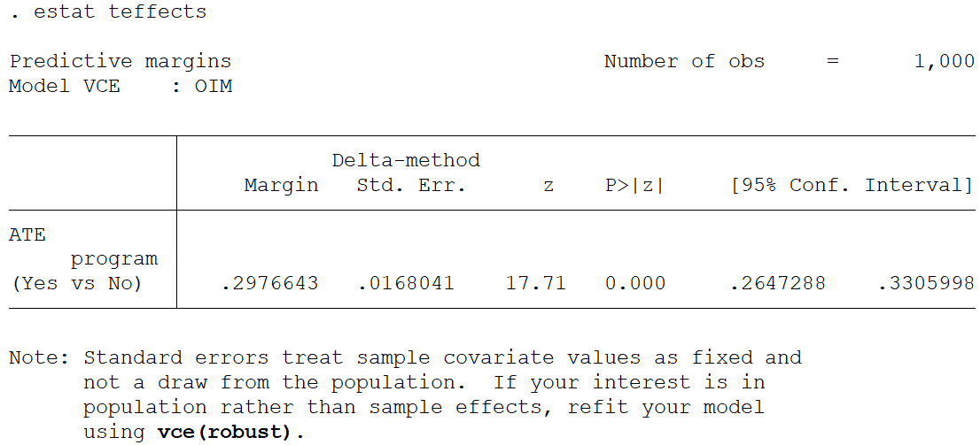
estat teffects

Slide 65
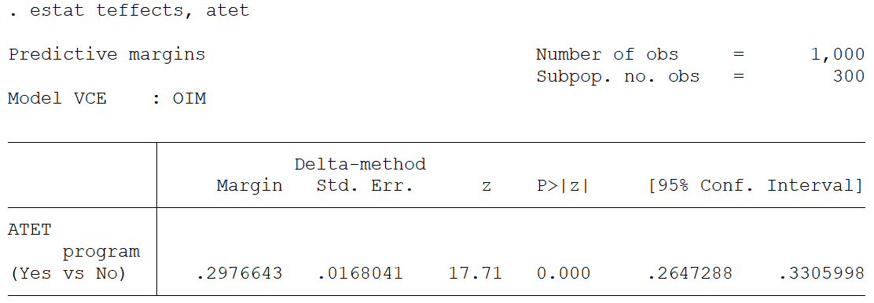
estat teffects, atet

Slide 66
margins

Slide 67
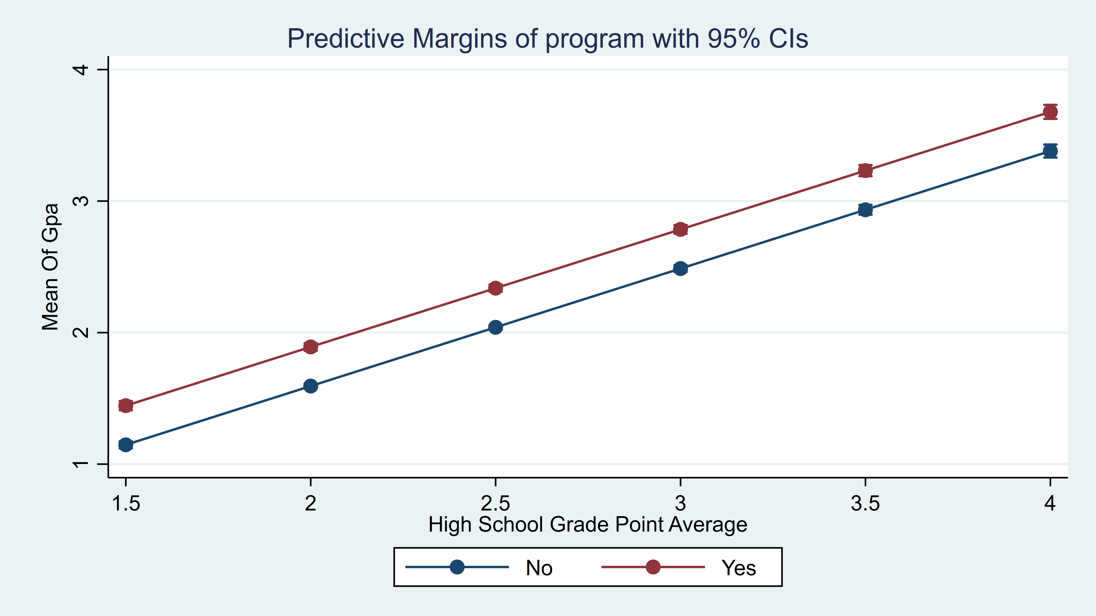
marginsplot
. marginsplot

Slide 68
More ERMs
eregress – continuous outcomes
eintreg – interval outcomes
eprobit – binary outcomes
eoprobit – ordinal outcomes

Slide 69
More About ERMs
ERMs can include:
polynomials of endogenous covariates
interactions of endogenous covariates
interactions of endogenous with exogenous covariates

Slide 70
Cautionary Note
Nothing about ERMs magically extracts causal relationships.
As with any regression analysis of observational data, the causal interpretation must be based on a reasonable underlying scientific rationale.

Slide 71
Acknowledgements
Charles Lindsey
Kristin MacDonald
Vince Wiggins

Slide 72
Thanks for coming!
Questions?
chuber@stata.com

